Slide 1
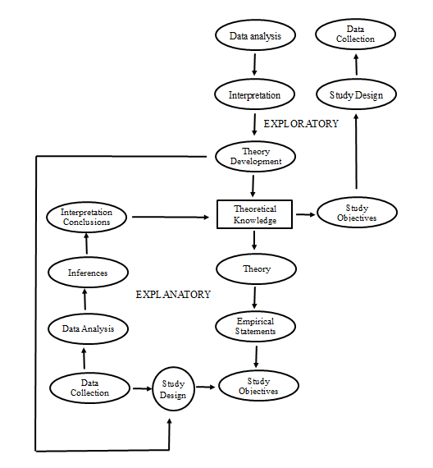
Lecture 13: Research Design

Slide 2
Designs
Experimental
  Random assignment of units
  Manipulation
Quasi-experimental
  Non-random assignment of units
  Manipulation
Observational
  Cross-sectional
  Retrospective
  Prospective

Slide 3
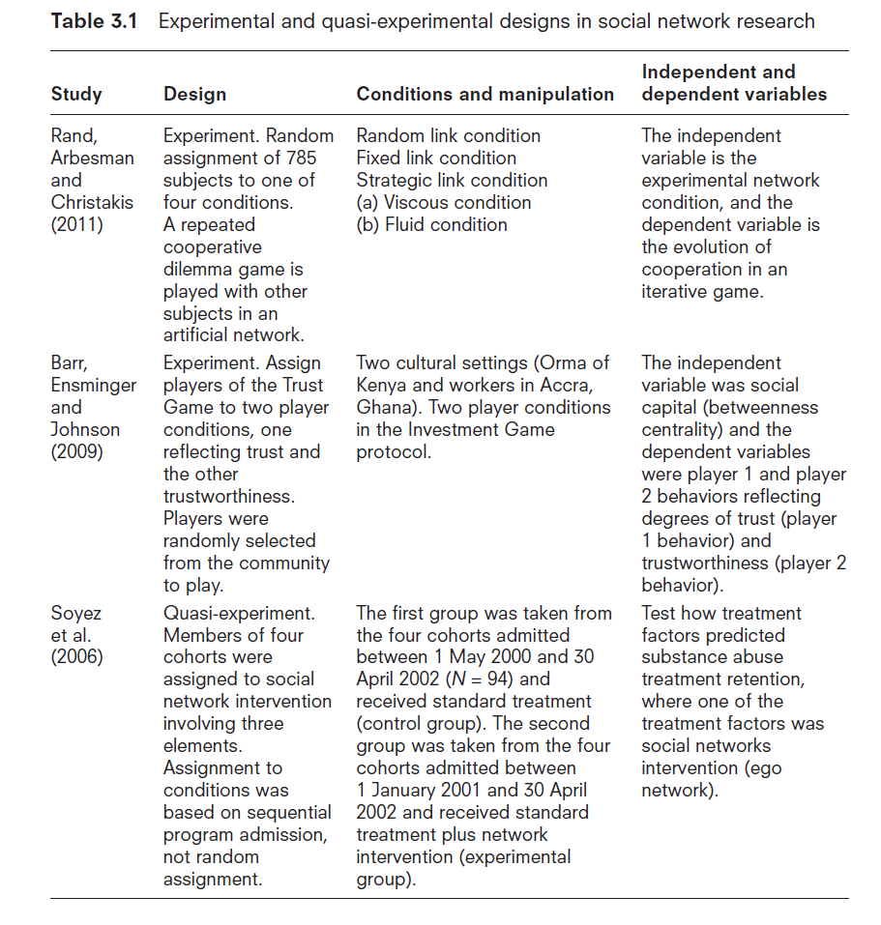

Slide 4
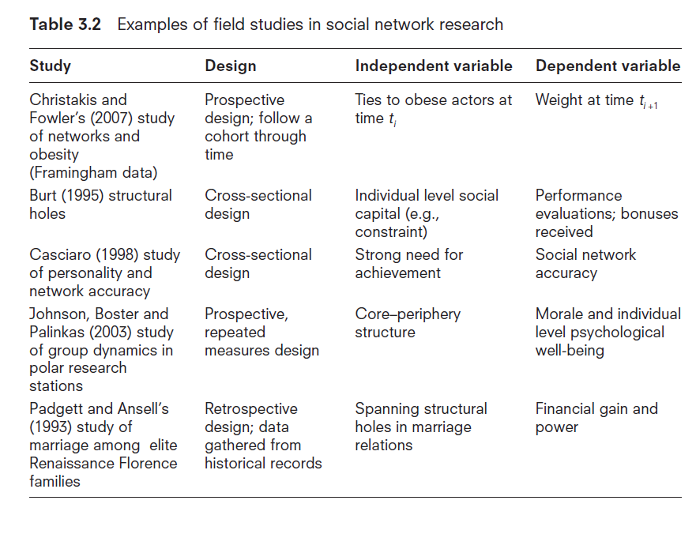

Slide 5
Remember to Always Think About What Is The Independent and What is the Dependent Variable!

Slide 6
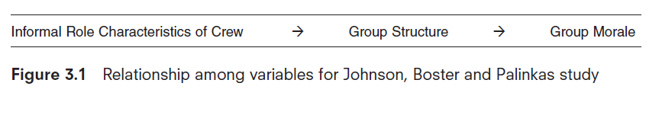

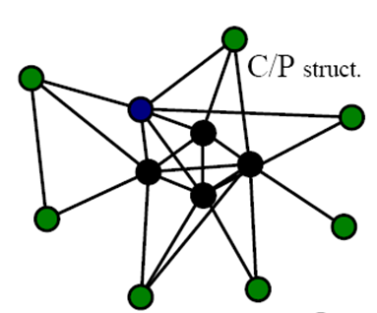

Slide 7
Strategies for Bounding Groups
Groups mostly have fuzzy boundaries
Even well defined organizations or social units have fuzzy boundaries (e.g., corporations)

Slide 8
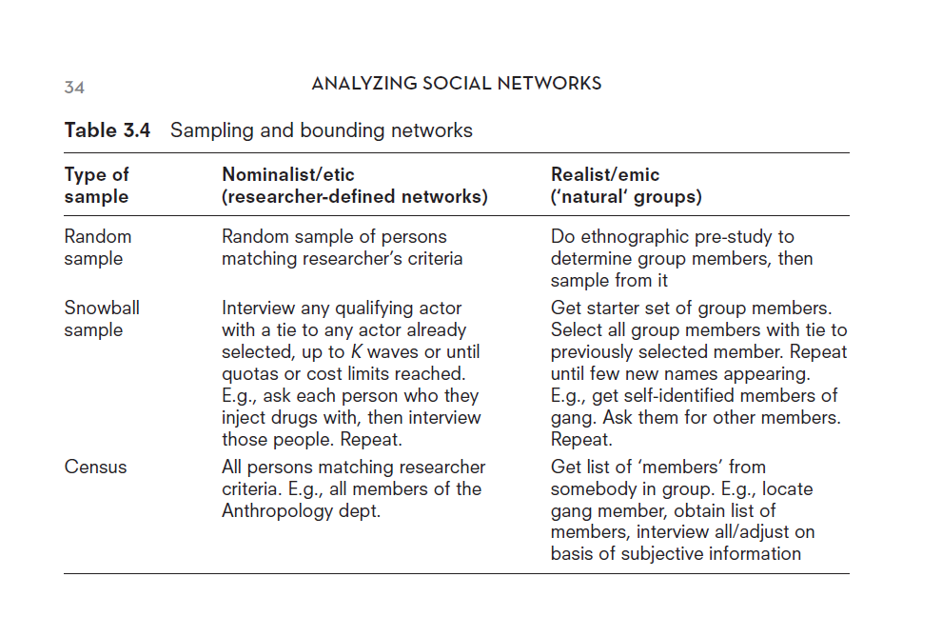
Sampling and Bounding

Slide 9
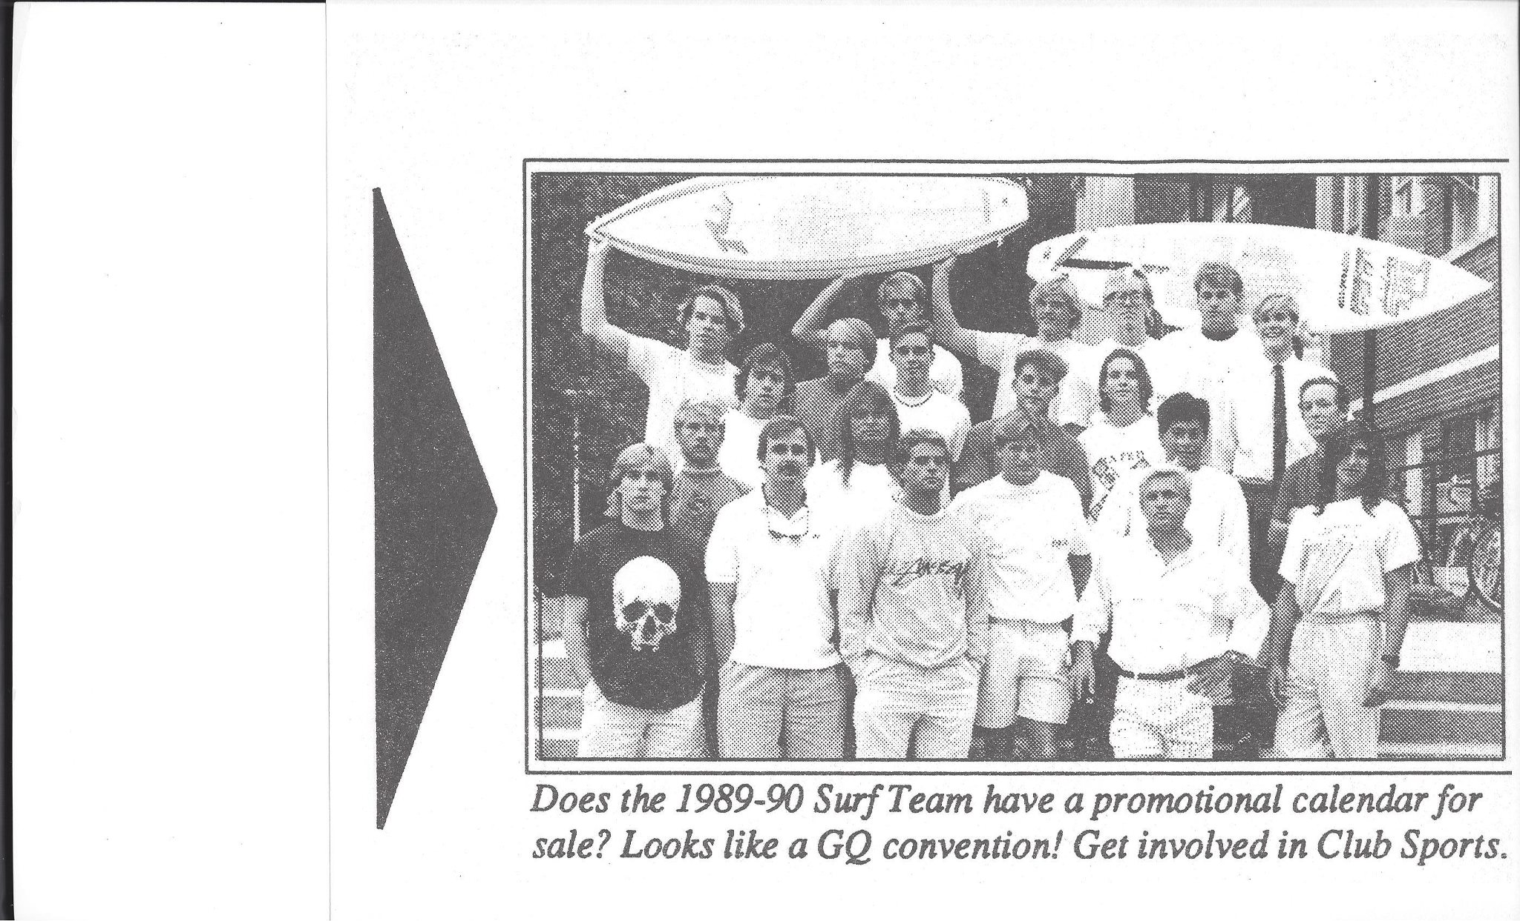
A Clear Group: Nominalist Criteria (etic)

Slide 10
Nominalist
There are clear members and non-members of the network
It is not that there are not network relations outside the group it is just that the hypothesized influences of network factors on behavior or behavior on network factors is exclusive to the group context (e.g., network structures effect on group performance)
Any threat to validity concerns unmeasured network influences on the study

Slide 11
Realist Strategies (emic)
Networks determined this way can have extremely fuzzy boundaries
Boundaries are derived from the potential members themselves or by the nominations of group members of other members
Possible difficulty in knowing where to draw the final boundary

Slide 12
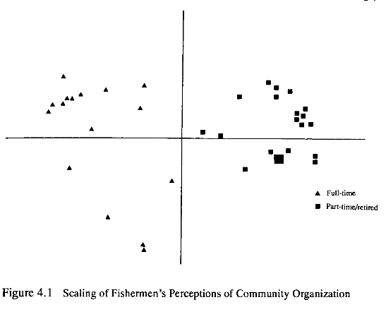
Empirically Derived Group: Realists (emic)

Slide 13
Snowball Sample and Boundaries
Snowball sample of actors associated with king mackerel fishing in the Southeast US
Random selection of initial set of actors (from license lists)
Each actor would then be asked to name k other people they talked to about king mackerel fishing (in this case k = 3)
This was then repeated for multiple waves until there was sufficient network closure (i.e., no new names being mentioned)

Slide 14
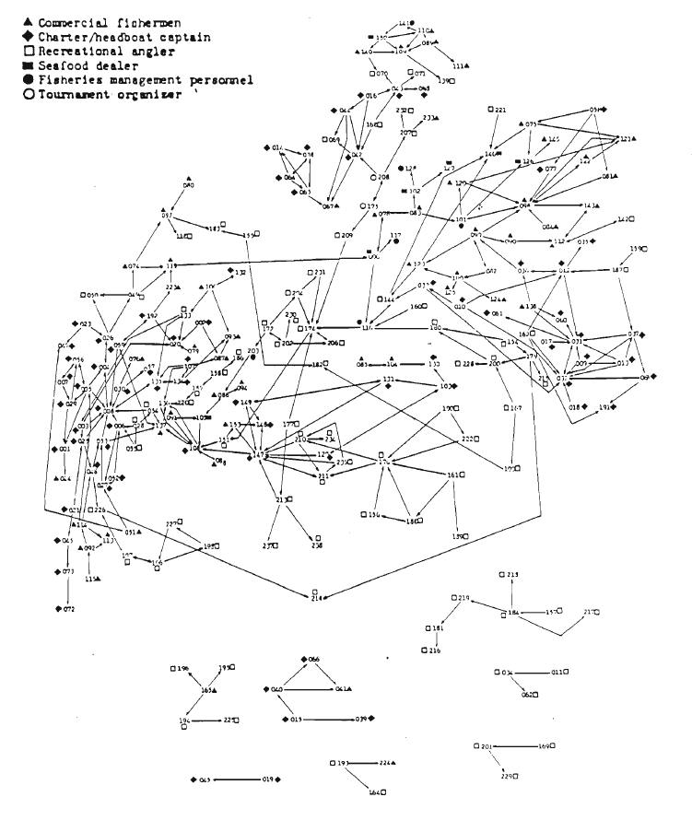
Yielded a Network of 238 Actors

Slide 15
Missing Data and Other Errors
Missing data in social network research is much more problematic than in other types of social research (e.g., nonresponse)
Must do everything possible to avoid missing data and errors of other kinds
Talked about some of these in data collection

Slide 16
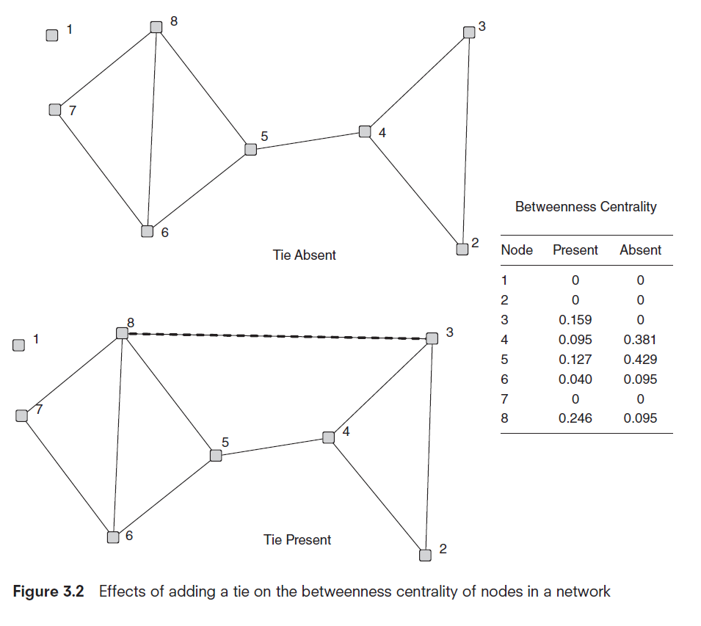
Impact of Errors

Slide 17
Types of Errors
Omission Errors
Commission Errors
Edge/node attribution errors
Data collection and retrospective errors
Data fusion/aggregation errors
Errors in secondary sources and data mining
Formatting errors

Slide 18
Omission Errors
Commission Errors
Missing edges and nodes can have huge impacts on errors in network variables, particularly for some centrality measures.
Like omission errors, the erroneous inclusion of nodes and edges can affect the ultimate determination of node-level measures and the identification of key nodes

Slide 19
Edge/node attribution errors
These result from assigning a behavior or attributing something to either an edge or node incorrectly. Misassignment of a behavior to a node can yield attributed linkages in a network that in reality do not exist. Attribution error is a common problem in the interpretation of two-mode data that has been converted to one-mode.

Slide 20
Data collection and retrospective errors
Care should likewise be taken when using network data collected from individuals where the network elicitation question deals with reports of behavior, particularly having to do with social interactions of a temporally discrete nature
BKS

Slide 21
Data fusion/aggregation errors
Decisions often have to be made on aggregating data on different temporal, relational and spatial scales. Such aggregations, if done improperly, can create errors at a variety of levels.

Slide 22
Errors in secondary sources and data mining
Various forms of secondary source data may have inherent biases which should be considered in any analysis. This type of data can be easier to collect than primary types of data (e.g., data scraped from the Web), but it can be fraught with errors at a variety of levels.

Slide 23
Formatting Errors
In data mining or web scraping there are errors that can be due to differences in document or website formatting. These errors can lead to the over- or under-representation of terms, actors, attributes, etc., in the data retrieval process.

Slide 24
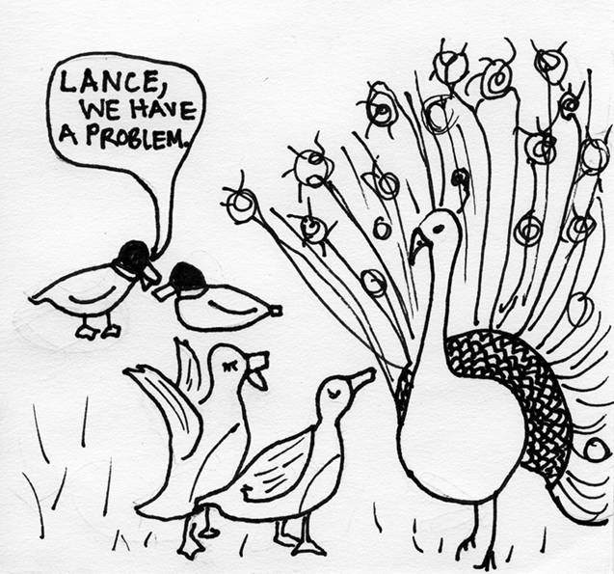
Next: Lecture 14 Theory in Networks
http://www.chineseenglish.com/wp-content/uploads/2009/11/birds-of-a-feather-flock-together.gif

